Slide 1
Nourriture - Connect People with Ingredients
fastDev@AngularJS
Beijing Jiao Tong University

Slide 2
Single Page App (SPA)
Beijing Jiao Tong University

Slide 3
What Web App
A web app is any software that runs in a web browser, and using a web browser as a client (thin client)
Web applications are popular due to the ubiquity of web browsers (cross-platform compatibility), that to update and maintain web applications without distributing and installing software on potentially thousands of client computers
Beijing Jiao Tong University

Slide 4
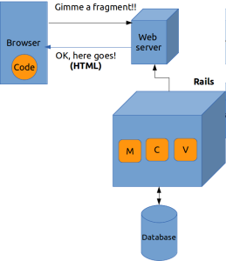
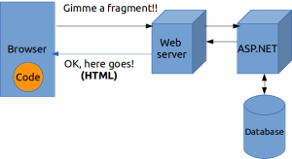
Web Page to Web App (HTML sent from server)
AJAX allowed for JavaScript code on the client side to request for a fragment of a page, then dynamically (i.e without going back to the server) refresh a part of the page (by updating the document in browser that is called DOM).
What was sent back was still HTML, but the code on the browser could stick in this HTML fragment inline to the current page.
Beijing Jiao Tong University

Slide 5
What Single Page App
In a SPA, either all necessary codes (HTML/JavaScript/CSS) are retrieved with a single page load, or the appropriate resources are dynamically loaded and added to the page as necessary, usually in response to user actions.
The page does not reload at any point in the process, nor does control transfer to another page.
Beijing Jiao Tong University

Slide 6
Characteristics of SPA
Chunking
The web page is constructed by loading chunks of HTML fragments and JSON data instead of receiving full HTML from a web server
Controllers
JavaScript handles DOM manipulations, app logic and AJAX calls is replaced by controllers that separates views and models (MVC or MVVM patterns)
Templating
Coding of UI and DOM manipulations are replaced by declarative binding of data to HTML templates
Routing
Selection of views and navigation (without page reloads) that preserves page state, elements and data
Real-time Communication
Two-way communication of a client application and web server replaces one-way requests from a browser
Local storage
Storing data on a browser for performance and offline access replace cookies and intensive data loads from web server
Beijing Jiao Tong University

Slide 7
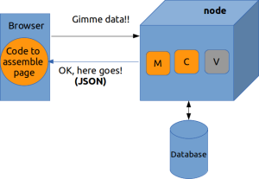
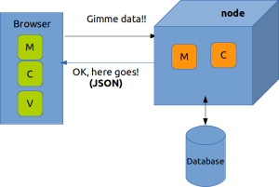
Web App to SPA (Data sent from server)
To simplify the “spaghetti” of jQuery code that was happening on the client side. What was needed was an “opinionated” way to assemble HTML pages on the client from data that was fetched from the server – AngularJS
jQuery
AngularJS
Beijing Jiao Tong University

Slide 8
AngularJS and Dependency Injection
Beijing Jiao Tong University

Slide 9
HTML vs. AngularJS
HTML is great for declaring static documents, but it falters when we declare dynamic views in web apps.
AngularJS uses good old HTML (or HAML, Jade and friends!) as the template language and lets us extend HTML’s syntax to express the app’s components clearly.
It automatically synchronizes data from the UI (view) with the JavaScript objects (model) through 2-way data binding.
It teaches the browser how to do dependency injection and inversion of control.
Beijing Jiao Tong University

Slide 10
What MVVM (Model View ViewModel)
Largely based on the MVC pattern, MVVM is a specific implementation targeted at UI development platforms which support event-driven programming.
MVVM facilitates a clear separation of the GUI (HTML) from the business logic (backend logic) known as the model
The VM (view model) of MVVM is a value converter that “model of the view” meaning it is an abstraction of the view that also serves in mediating between the view and the model which is the target of the view data bindings.
Beijing Jiao Tong University

Slide 11
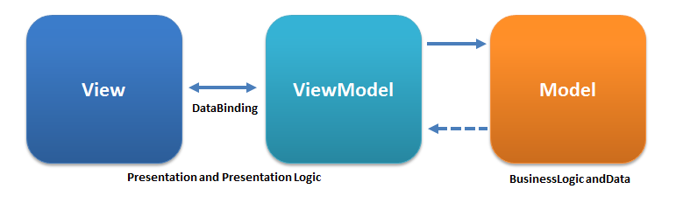
How MVVM (Model View ViewModel)
MVVM was designed to make use of data binding functions to better facilitate the separation of view layer development from the rest by removing virtually all GUI code (“code-behind”) from the view layer.
It acts as a converter for two-way communication that changes model information into view information and passes commands from the view into the model.
Benefit: Designers focus UX and Developer focus business logic
Beijing Jiao Tong University

Slide 12
MVVM has Controller?
MVVM. Don't be fooled by the letters, by the omission of the C. Controllers are still there.
It just adds one thing: statefulness, data cached on the client. That data now gets called “ViewModel”. It's what allows rich interactivity.
MVVM = model, controller, cache, view = two-way communication = rich interactivity
For example, model usually sits on the server, whereas ViewModel lives on the client. So it's no feasible for HTML to bind directly to server-side Model. Therefore we need ModelView which acts as a local, unsaved working set of data extracted from model using e.g. AJAX/JSON
Beijing Jiao Tong University

Slide 13
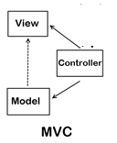
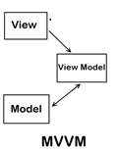
MVC vs. MVVM
User gets view update upon model manipulation via view model
User uses controller manipulates model to update view
The View is aware of the Model, but the Model has no knowledge of any Views that are consuming it
View doesn’t have any knowledge of or reference to the controller.
The Controller does pass back the Model, so there is knowledge between the View and the expected Model being passed into it, but not the Controller serving it up.
While the View holds a reference to the View Model, the View Model has no information about the View.
View has no idea about the Model . This is because, as far as the View knows, its “Model” is the View Model thanks to data-binding.
Beijing Jiao Tong University

Slide 14
What Inversion of Control
"Hollywood Principle: Don't call us, we'll call you".
IoC describes a design in which custom-written portions of a computer program receive the flow of control from a generic, reusable library.
With IoC (Reverse), it is the reusable code that calls into the custom, or task-specific code.
Benefit:
It is used to increase modularity of the program and make it extensible
Beijing Jiao Tong University

Slide 15
How Inversion of Control
The flow depends on the object graph that is built up during program execution (run-time)
Such a dynamic flow is made possible by object interactions being defined through abstractions.
This run-time binding is achieved by mechanisms such as dependency injection
Beijing Jiao Tong University

Slide 16
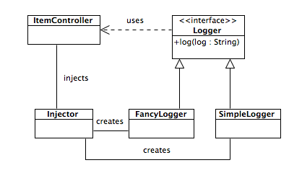
What Dependency Injection
It is a software design pattern that implements inversion of control and allows a program design to follow the dependency inversion principle
An injection is the passing of a dependency (a service) to a dependent object (a client).
Passing the service to the client, rather than allowing a client to build or find the service, is the fundamental requirement of the pattern.
High-level modules should not depend on low-level modules. Both should depend on abstractions
Abstractions should not depend on details. Details should depend on abstractions.
Beijing Jiao Tong University

Slide 17
Key Components of AngularJS
Beijing Jiao Tong University

Slide 18
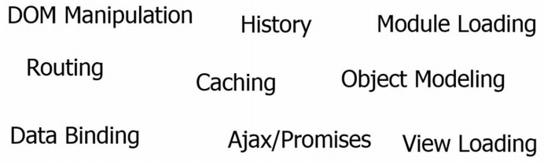
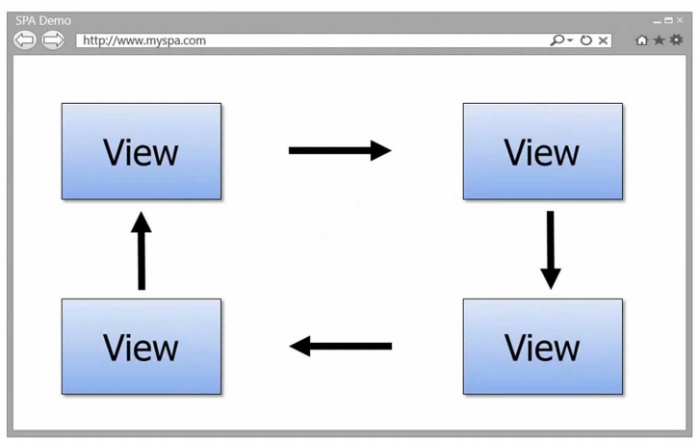
Key Challenges of SPA
A SPA is one in which we have a shell page and we can load multiple views into that
Beijing Jiao Tong University

Slide 19
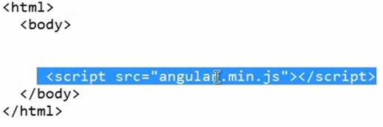
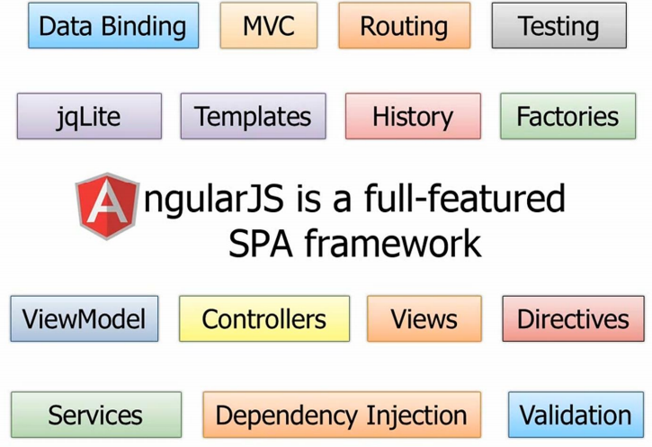
SPA Framework - AngularJS
a Framework but NOT a Library
Beijing Jiao Tong University

Slide 20
Directives, Filters and Data Binding
Beijing Jiao Tong University

Slide 21
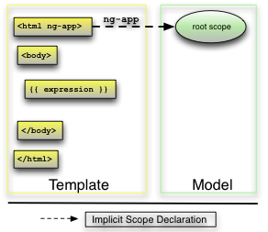
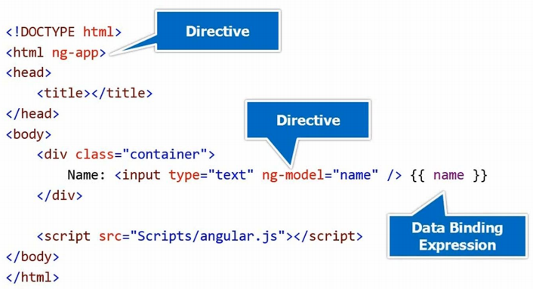
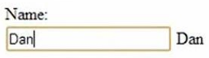
Directives ng-model Teach HTML new tricks
Flag the html element that Angular should consider to be the root element of the app
scope.name
Binding to property
Extend HTML and add property for view that input
Add a property up in the memory called “name” into what’s called “the scope”
Evaluate an expression and insert the result into the DOM in place of the binding. Binding will result in efficient continuous updates whenever the result of the expression evaluation changes.
making an empty ViewModel of MVVM pattern but then filling it with a name property
Ng-model adds scope in scope reference chain which extend HTML by adding property for view
Beijing Jiao Tong University

Slide 22
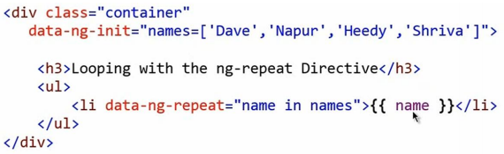
Iterating with the ng-repeat Directive
Evaluate an expression and insert the result into the DOM in place of the binding. Binding will result in efficient continuous updates whenever the result of the expression evaluation changes.
Binding to variable
“name” is just a variable, but NOT view model.
ng-repeat which simply loops through all the names
and then data-bind or apply the value into the <li
Beijing Jiao Tong University

Slide 23

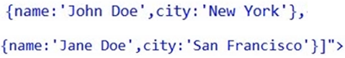

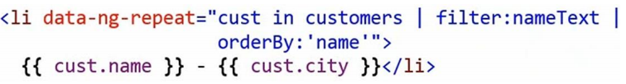
Iterating with the ng-repeat Directive by Filter
Oder results by name
view model
variable
Filter results by
“nameText” property that ViewModel
Binding to variable
Before user types texts in input, list displays nothing. When user types texts in input, list is composed of the filtered result ordered by ‘name’ among the initialized list contents
Beijing Jiao Tong University

Slide 24
Views, Controllers and Scope (ViewModel)
Beijing Jiao Tong University

Slide 25
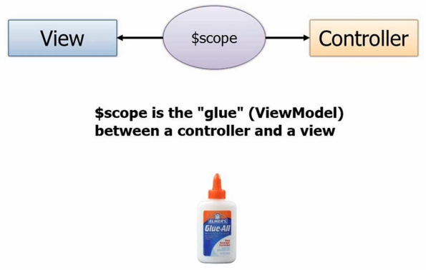
What Scope (ViewModel = Model for View)
A JavaScript object – a container
1. Control ultimately what data gets bound into the View
2. Passes up data from View to the Controller (maybe to backend data store)
$scope represents the scope object
The view doesn’t have to know about the controller, and the controller definitely doesn’t want to know about the view
Beijing Jiao Tong University

Slide 26
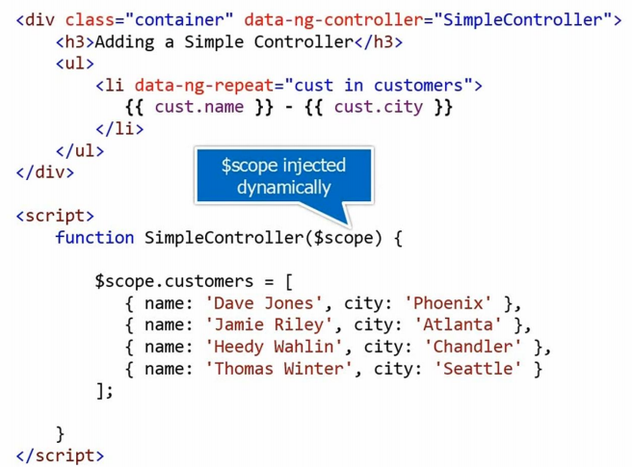
Dependency Injection and Controller
When controller gets used, it will automatically inject a scope object in.
Access $scope to bind property to view via expression
Add a property onto scope
The controller itself though isn’t going to be called – it’s going to go through the scope. The scope itself is implicitly available – in this case to the entire div: from the start of the div to the end of the div.
We pass $scope. This is dependency injection that’s built into AngularJS, it passes the service to the client
Beijing Jiao Tong University

Slide 27
Modules, Routes and Factories
Beijing Jiao Tong University

Slide 28
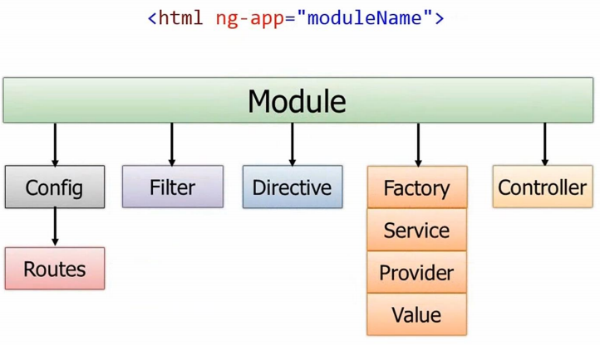
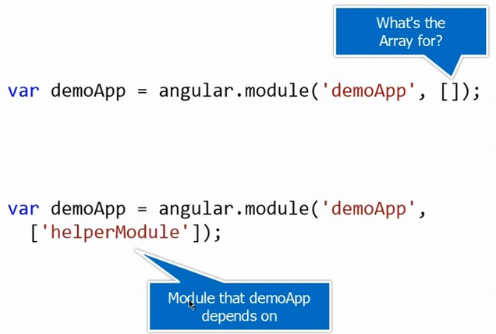

What Module
Module is an object container
It can configure the routes, create custom filters, custom directives.
It can get data from different sources using Factories, Services, Providers or Values.
It can create Controllers using the module.
Use the module
For different view, such as for mobile, tablet, desktop, etc
Get data from locally or remotely
Dependency injection to let module could rely on other modules to get data
Module can have all these different things in, and it need to be pointed to ng-app
Beijing Jiao Tong University

Slide 29
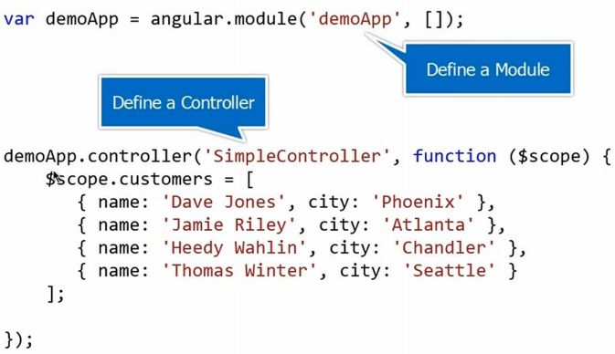
Create a Controller in Module
anonymous function
$scope are injected in the controller for the property that the array ‘customers’
Beijing Jiao Tong University

Slide 30
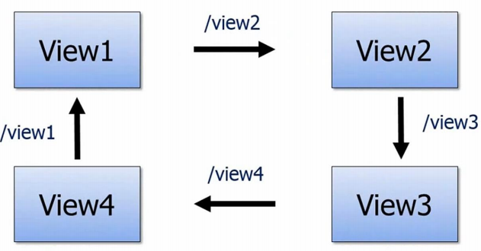
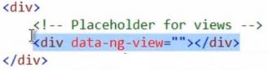
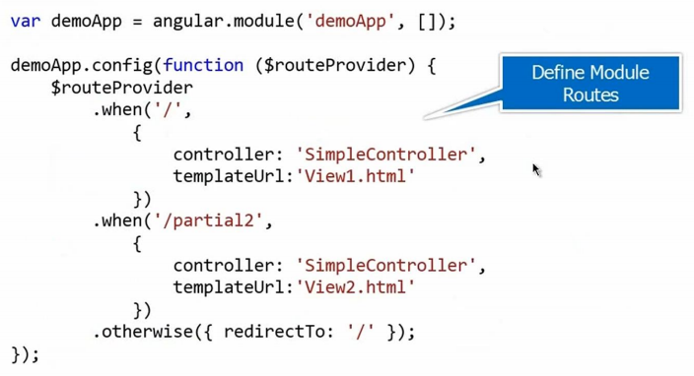
What Routes
It helps us load different views into shell page
The placeholder for the views
When my routes kick in and we go to a default route what will happen is the “/”, and is going to be married to the controller, then is going to be injected dynamically into the <div>
Configure the module with routes.
routeProvider is an object and is kind of like the scope – it’s injected in dynamically just by defining $routeProvider as the parameter.
it is root of routes
Beijing Jiao Tong University

Slide 31
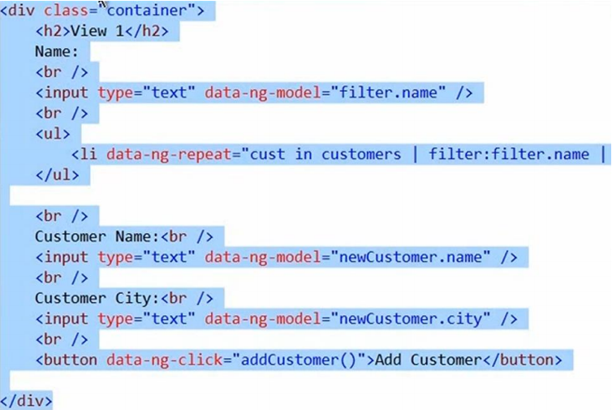

Route among different Views @ View 1
Root scope -> scope (input)
Add property in memory named as “filter.name”
Root scope -> scope (input)
Add property in memory named as “newCustomer.name”
Root scope -> scope (input)
Add property in memory named as “newCustomer.city”
addCustomer will be called if button is clicked
Beijing Jiao Tong University

Slide 32
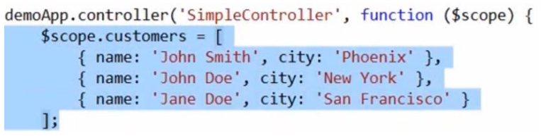
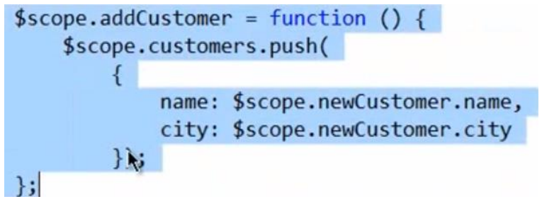
Func @ addCustomer
The view binds to the scope then we need to say “$scope.addCustomer” and assign that to a function
scope.customers is object that array in memory
scope.addCustomer is object that func in memory
Array operation @ push
Why
Because all of them are referenced as properties in memory by root scope
Beijing Jiao Tong University

Slide 33
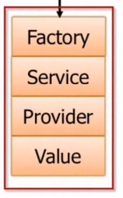
What Factory
Factory: Create an object inside of the factory and return it.
Service: Have a standard function that uses the this keyword to define function.
Provider: There’s a $get you define and it can be used to get the object so as to return the data
Value: To get a config value for example
Beijing Jiao Tong University

Slide 34

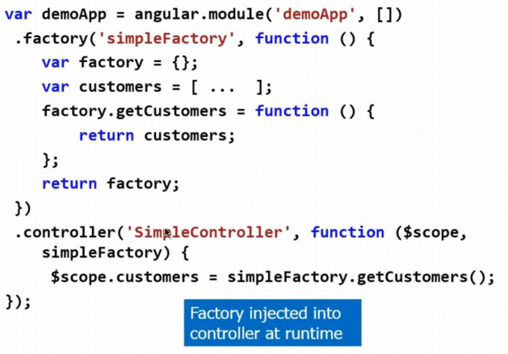

How Factory
When controller gets used, it will automatically inject a scope object and factory object in
If I want a ajax call in factory, I just need to add http object that $http as parameter
Factory creates object and return objects
simpleFactory is injected into controllel, which has referrence to the factory
$scope is injected into controller, which has reference to array that customers in memory
Beijing Jiao Tong University

Slide 35
Reference
http://act2.me/full-stack-web-development/
http://en.wikipedia.org/wiki/Inversion_of_control
http://en.wikipedia.org/wiki/Dependency_injection
http://fastandfluid.com/publicdownloads/AngularJSIn60MinutesIsh_DanWahlin_May2013.pdf
https://github.com/gurjeet/AngularJSDemos
http://stackoverflow.com/questions/667781/what-is-the-difference-between-mvc-and-mvvm
http://en.wikipedia.org/wiki/Model_View_ViewModel
http://geekswithblogs.net/dlussier/archive/2009/11/21/136454.aspx
https://github.com/angular/angular.js/wiki/Understanding-Scopes
Beijing Jiao Tong University

